Slide 1


TCRHCC CEO Update
Joette Walters
638 Association Meeting
July 24 & 25, 2026

Slide 2

Our Mission is to provide safe, accessible, quality, and culturally sensitive healthcare.
Our Vision is embracing health living to heal, to respect, to console.
We take pride and honor the dignity in all individuals. We promise to uphold a safe environment, dedicated to quality, and a vision of excellence for today and tomorrow.
2

Slide 3
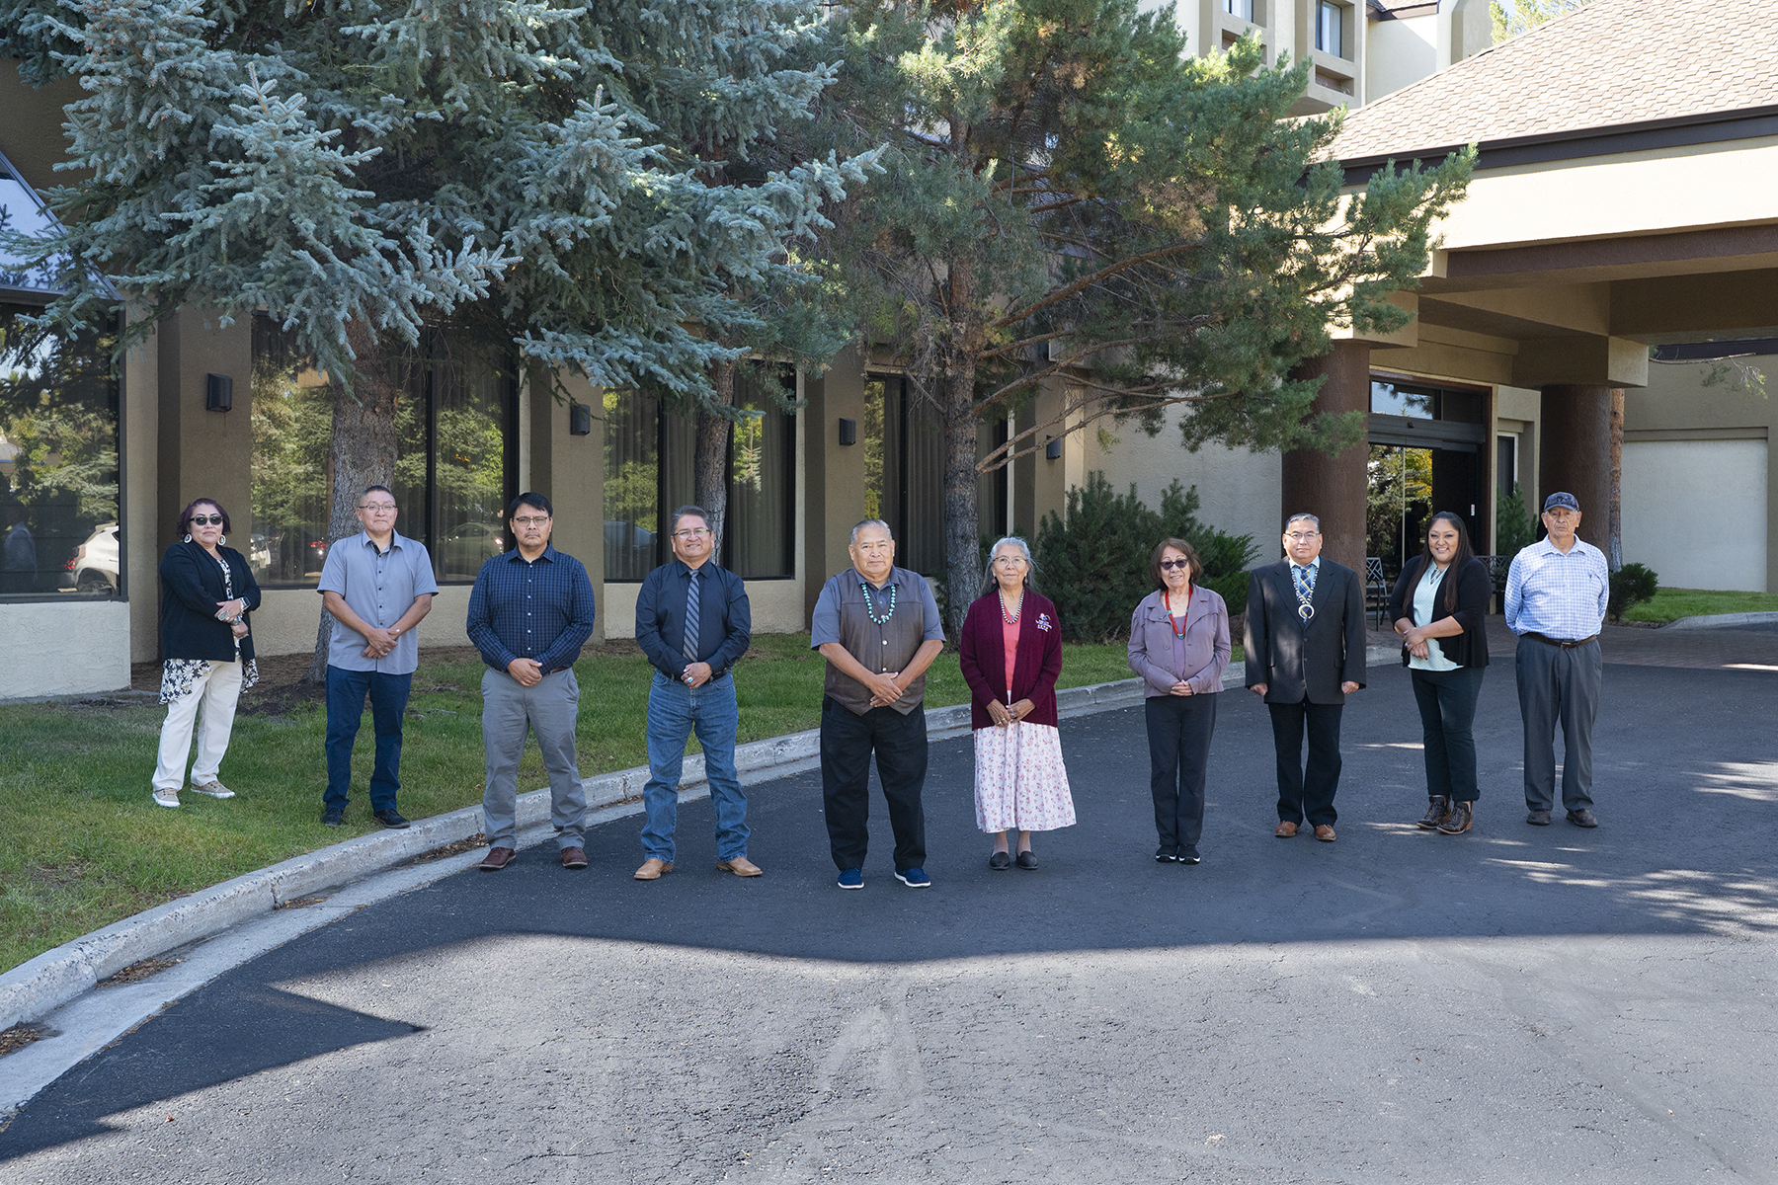
Board of Directors
3

Slide 4
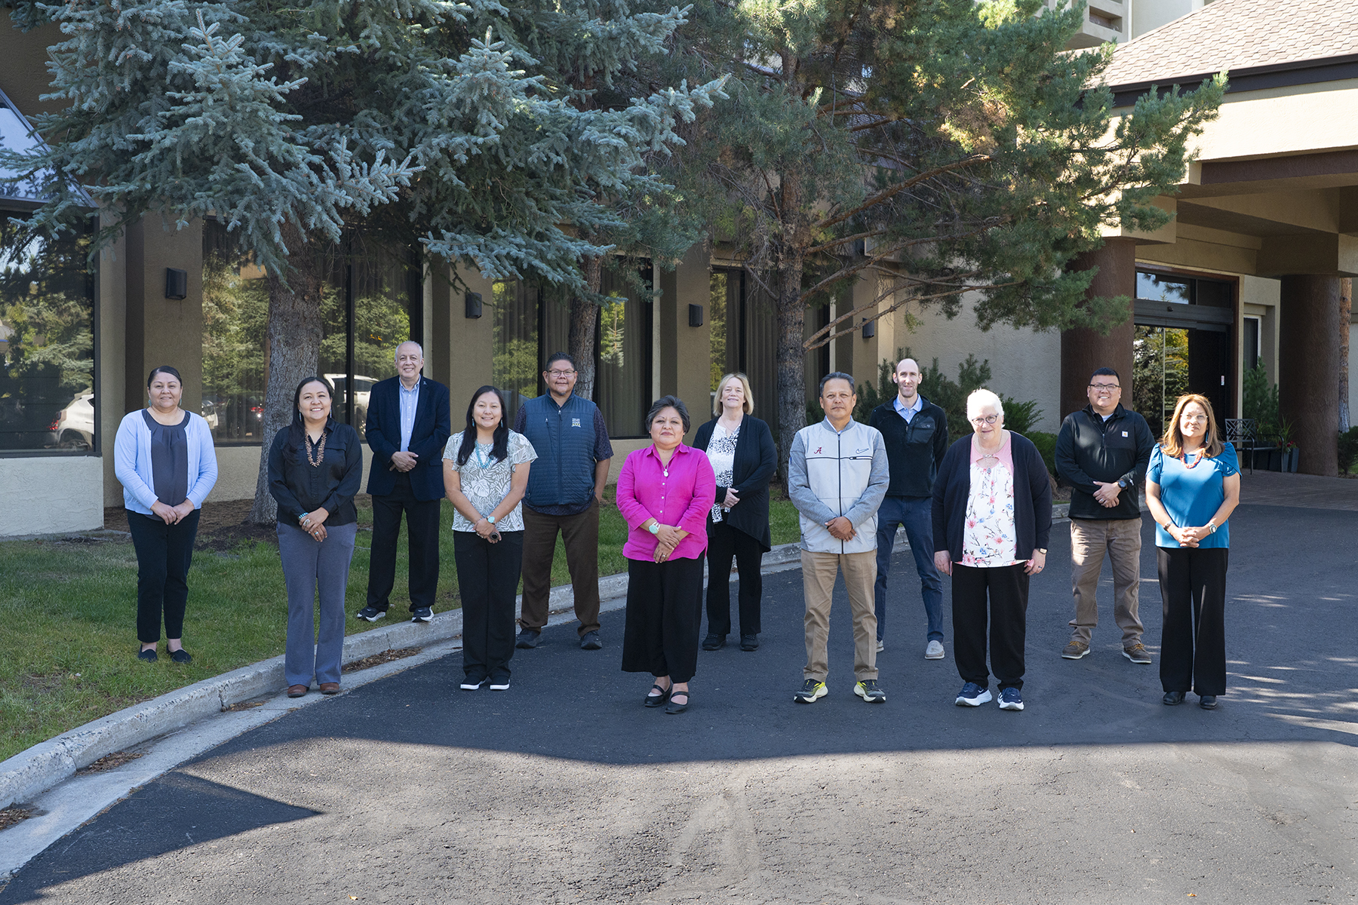
Senior Leadership Council
4

Slide 5
Our Campuses
Tuba City Regional Health Care Corporation
167 N Main Street
P.O. Box 600
Tuba City, AZ 86045
Call Center: 1-866-976-5941
Sacred Peaks Health Center
6300 N Highway 89
Flagstaff, AZ 86004
Phone: 928-863-7333
Call Center: 1-866-976-5941
LeChee Health Center
3 Miles South Coppermine Road
(Located North of the LeChee Chapter House)
LeChee, Arizona
Phone: (928) 698-4900
Call Center: 1-866-976-5941
Kaibeto Creek Independent Living Center
Kaibeto, AZ 86053
Contact: TCRHCC Housing Manager
Call Center: 1-866-976-5941
Cameron Clinic
Cameron Health Care & Dental
Highway 89 North, Mile Post 466 US
Cameron, AZ 86020
Call Center: 1-866-976-5941
TCRHCC Service Unit Area
Hopi Reservation
TCRHCC Campus Locations
5

Slide 6
Current Accreditations & Certifications
Tuba City Regional Health Care is honored to receive a wide range of industry awards and recognitions. Everyday we’re proud of the affiliations, accreditations, designations and partnerships we have with some of the top health care organizations in the world. Our recognitions measure the quality of care we provide our patients and the unwavering commitment to being the best community healthcare system on the Navajo Nation.
6

Slide 7

TCRHCC is Joint Commission Accredited
Hospital Accreditation Program, July 12, 2025
Patient Centered Medical Home, July 12, 2025
Home Care Accreditation Program, July 10, 2025
Laboratory Accreditation Program, June 26, 2025
7

Slide 8
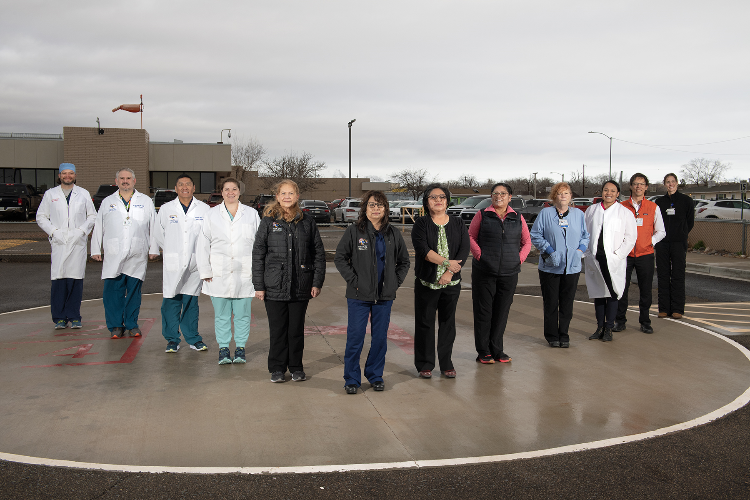
Level III Trauma Designation by the
American College of Surgeons &
Arizona Department of Health Services
Designated as a Level III Trauma Center
by the American College of Surgeons
Tuba City Regional Health Care is the first and only hospital on the Navajo Nation – and one of just eight total organizations – in Arizona designated as a Level III Trauma Center.
8

Slide 9
Additional Accreditations & Certifications
American College of Radiology (ACR) for Mammography, CT and MRI
Baby Friendly Designation
Arizona Perinatal Trust for Level II Perinatal Care Center
Arizona Department of Health Services for Sacred Peaks Health Center
American Association of Diabetic Educators (AADE)
9

Slide 10
Patient Visit Volumes
10

Slide 11
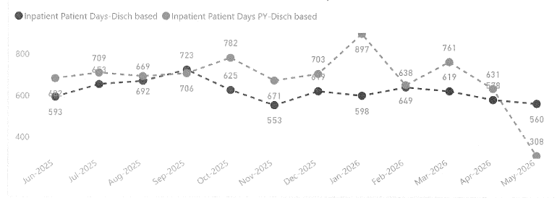
Inpatient Days, based on discharge

Slide 12
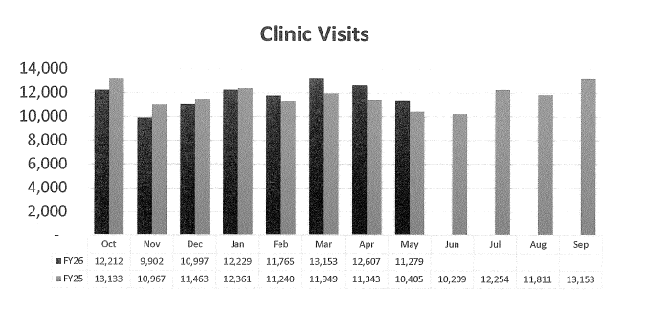

Slide 13
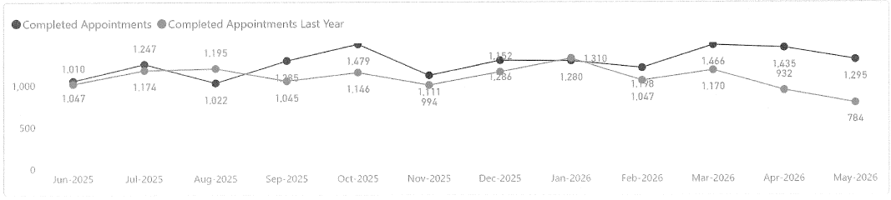
Dental Clinic Visits

Slide 14
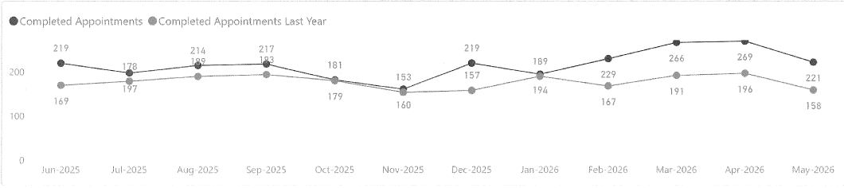
Specialty Care (Oncology & Infusion Therapy)
Notes:
Increase– 25% FYTD increase

Slide 15
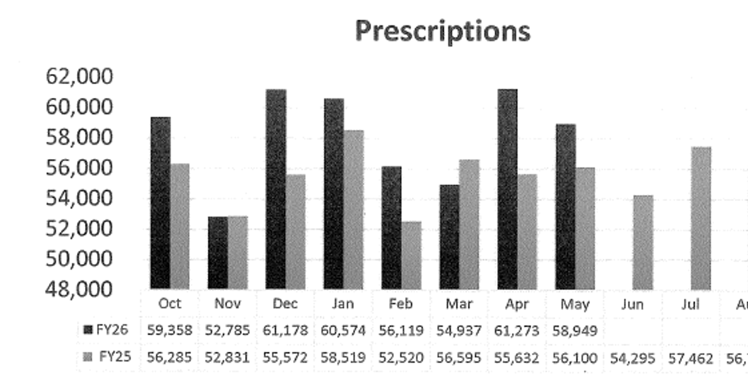

Slide 16
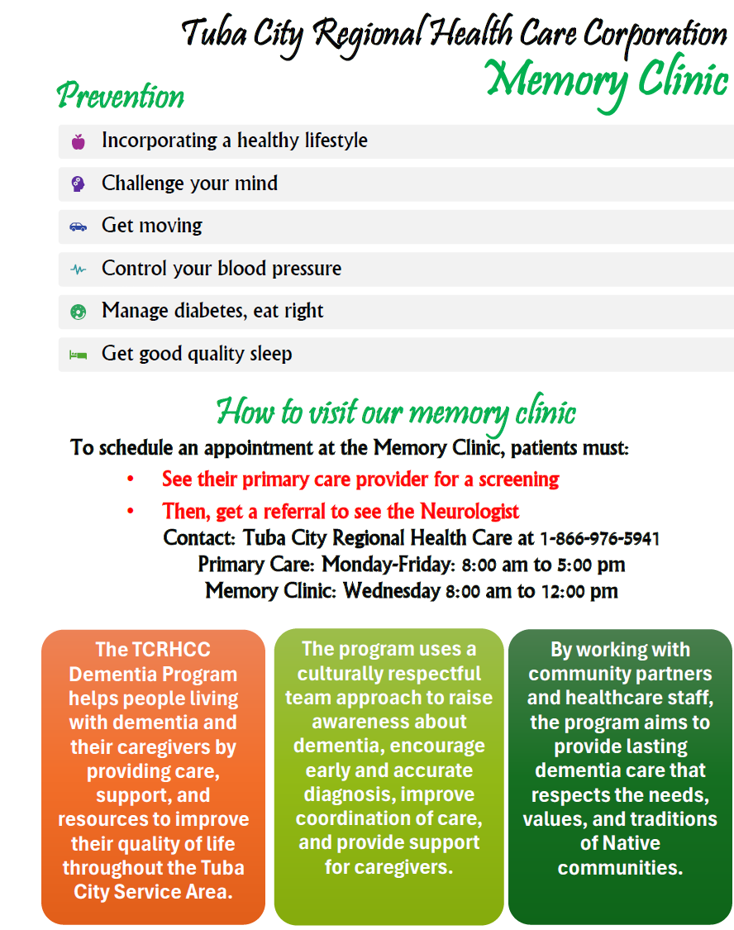

Slide 17
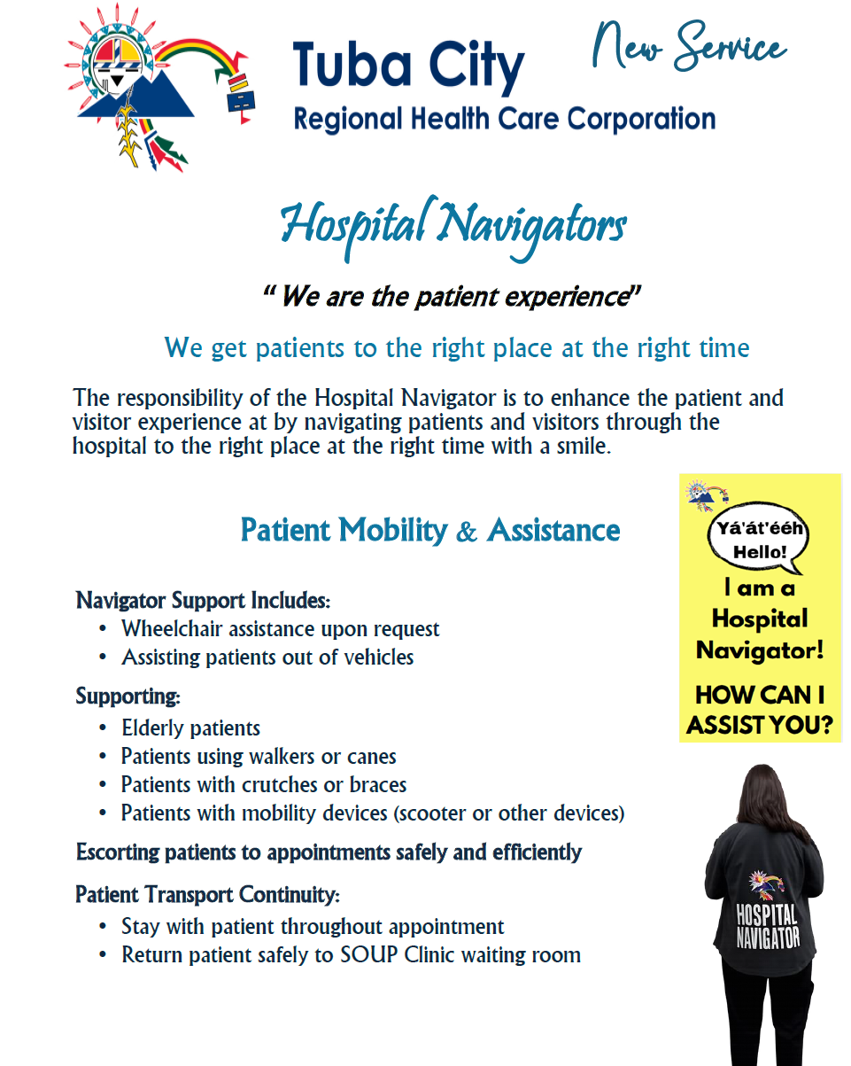

Slide 18

Workforce
1123 Total FTEs
  75% Tier 1 (Navajo, Hopi, San Juan Southern Paiute)
  Actively Recruiting for Echo Cliffs Health Center
  Navajo Nation Workforce Program
  Certified Pharm Tech Program– Cohort #9

Slide 19


Slide 20
Capital Projects
Echo Cliffs Health Clinic Construction
Beneficial Occupancy June 2026
Grand Opening OCT 5, 2026
Echo Cliffs Housing -
Phase I: August 31, 2026
60 hotel style units & 10 single family units
Phase II: December 31, 2026
22 single family units
TCRHCC 48 Housing Units
Completed April 2026

Slide 21
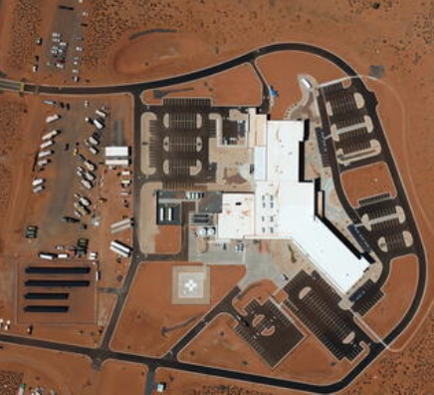
Echo Cliffs Health Clinic

Slide 25
Echo Cliffs Staff Quarters

Slide 26
Echo Cliffs Staff Quarters

Slide 27
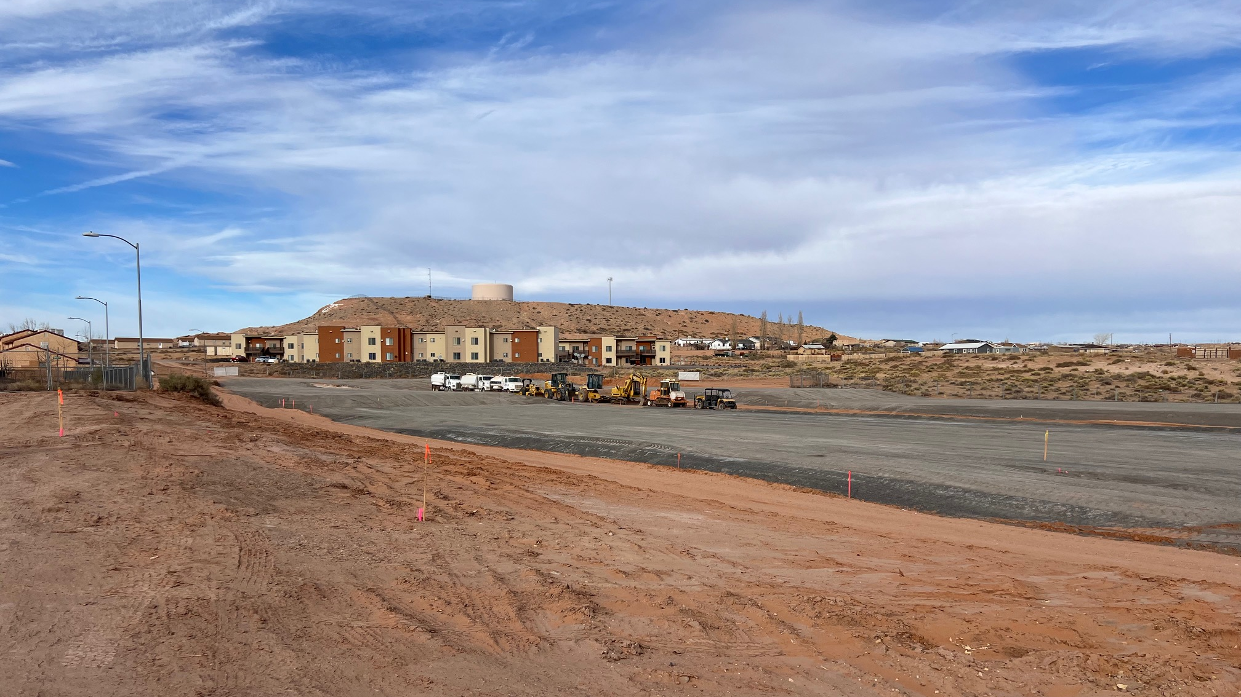
TCRHCC 48 Housing Units

Slide 28
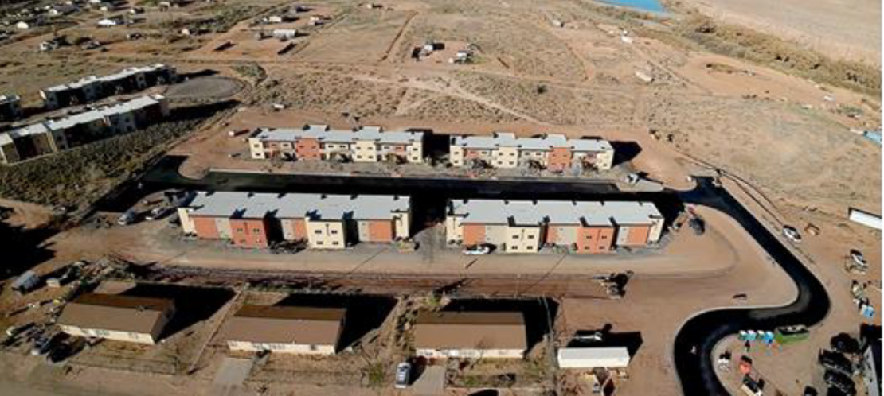
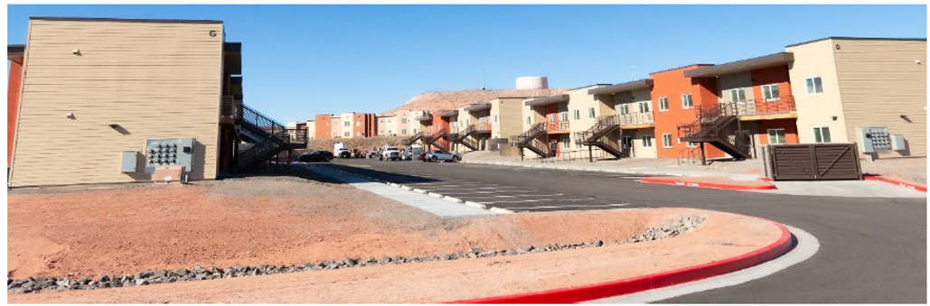

Slide 29
Long Term Care

Slide 30
Vision for a New Hospital
Tuba City Regional Health Care Corporation
Hospital Replacement Project Visualization
30

Slide 31

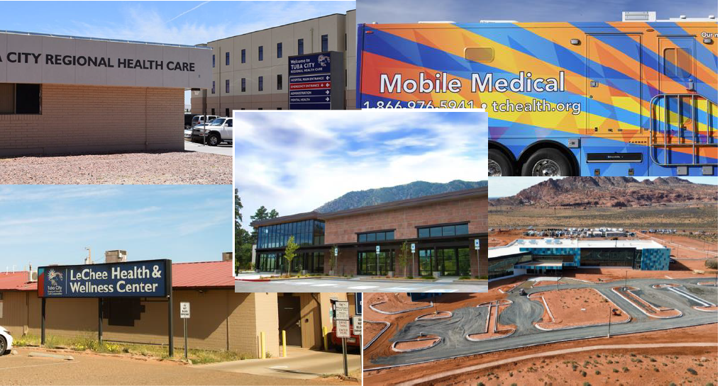

Slide 32
Ahe’hee! Thank you for your support and advocacy
Tuba City Regional Health Care Corporation
Administration Office: (928) 283-2784 or (928) 283-2827
www.tchealth.org
32

